Slide 1

Lost Votes Challenge (Prototype submission round)
Team Details
Team Name: Shahrukh Khan
Team Leader name: Shahrukh Khan
Team Leader email & phone number: shahrukh775584@gmail.com, 7755841616
Team members name: Shahrukh Khan

Slide 2
Lost Votes Challenge
Description of idea/abstract:
The Idea which came in my mind that we can make a secure mobile application which include voter id and password for that application and required some details that voter need to feel before giving the vote.
Required details are below.
Voter user name and password for log in or sing up for register.
Voter finger print that match with his aadhaar finger print.
Voter address that match with his voter id card.
After feeling all the details now he can select the candidate to give vote.

Slide 3
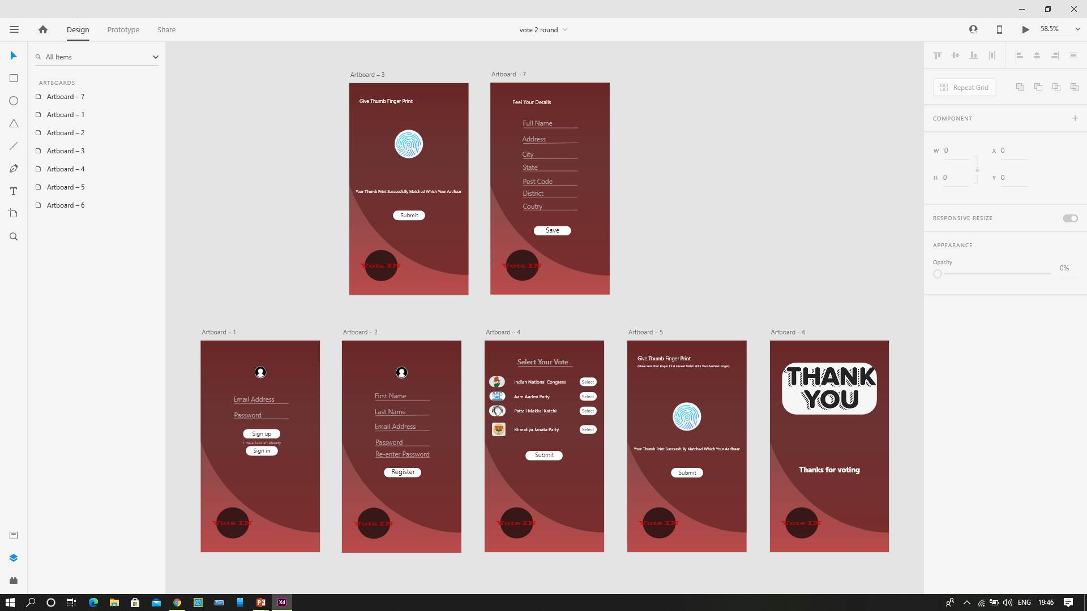
Lost Votes Challenge
Describe what you have built:
I have built a prototype that will show how application will be look like
And I have create seven pages step by step which include all the details
You can look picture below.
You preview all the pages very clearly from where I attached the zip file

Slide 4
Lost Votes Challenge
Technology Used:
Adobe XD
Photoshop

Slide 5
Lost Votes Challenge
GitHub Link :
https://github.com/shahrukh7755/-Lost-Votes-Tech-Solutions-Challenge

